Slide 1
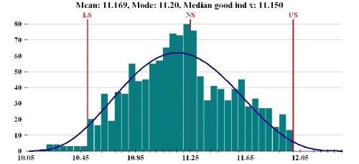
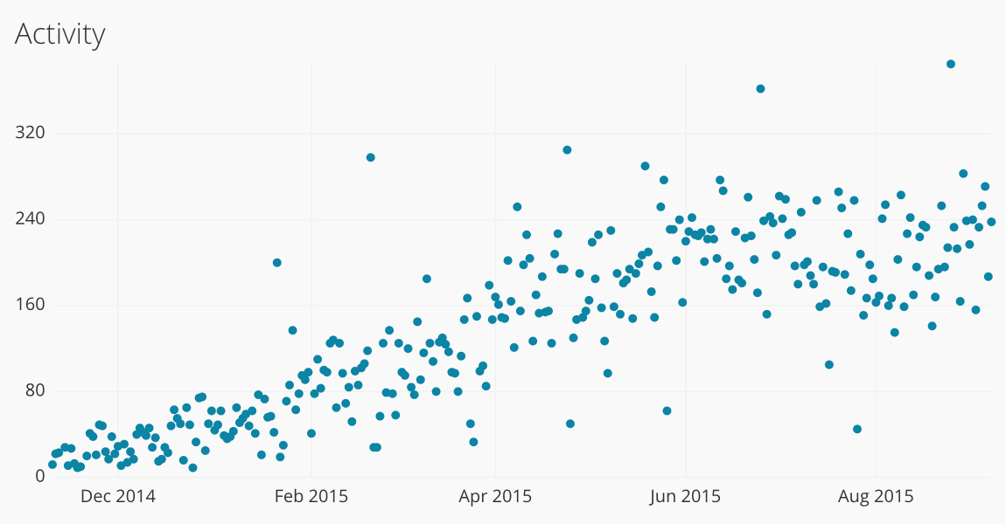
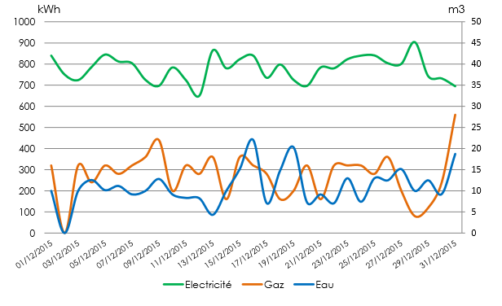

Statistical Charts
A Guide.

Slide 2
We Will divide Statistical Charts by The kind of data that they are best suited to display.

Slide 3
Categorical Vs. Quantitative
Categorical
Bar Chart
Pie Chart
Quantitative
Histogram Line Chart
Box Plot Scatter Plot

Slide 4
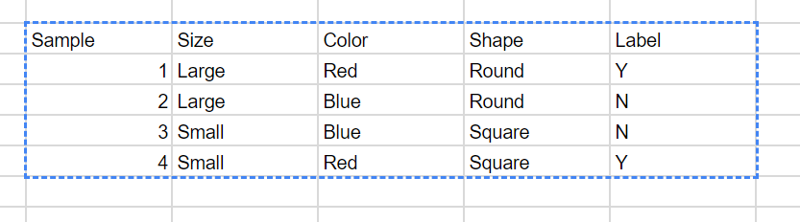
Categorical Data

Slide 5
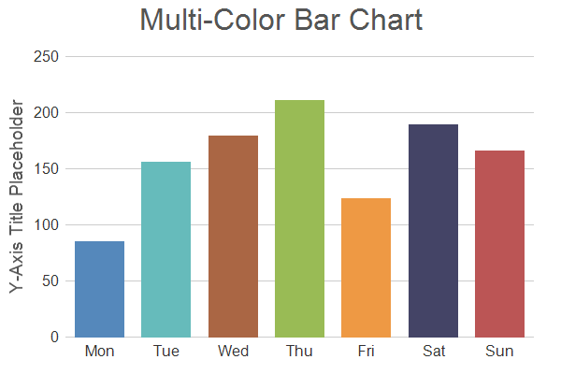
Bar Chart
Each Bar Represents a category.
Magnitude of Bar can represent a relative or absolute value.
Generally used to show the frequency of a list of categories.
Example:
# of laps run x Day of Week

Slide 6
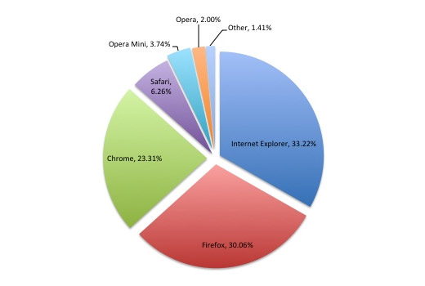
Pie Chart
Each slice Represents a category.
Generally, each slice is used to show the relative frequency of each category when compared to a whole.
Example:
Market share x browser

Slide 7
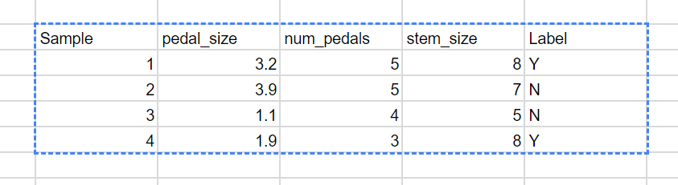
Quantitative Data

Slide 8
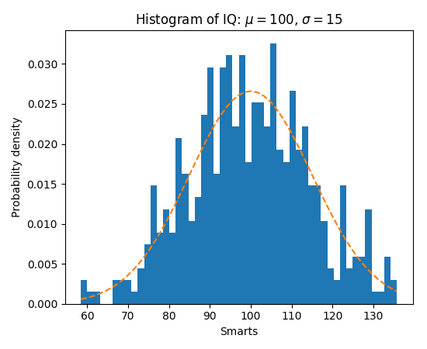
Histogram
Summary plot for a SINGLE variable.
Great for visualizing distribution:
Center and Variability
Skewness and Modality
Outliers or Strange Patterns.
Powerful when single feature histograms are all viewed side by side.

Slide 9
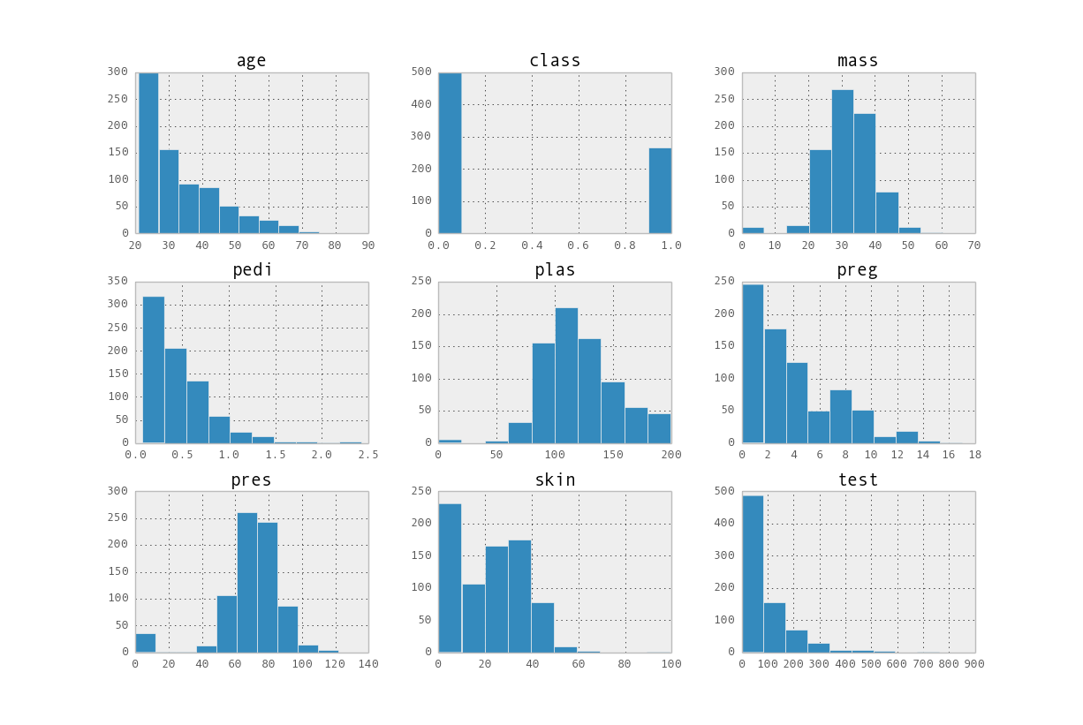
Ideal Use Case:
Multiple Histograms Viewed Side By Side.

Slide 10
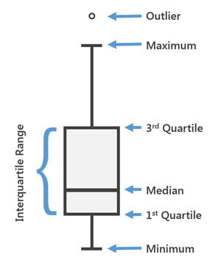
Box Plot
Shows 5-number Summary for a SINGLE variable.
Hard to view distribution at large.
Great when comparing the scale of different features.

Slide 11
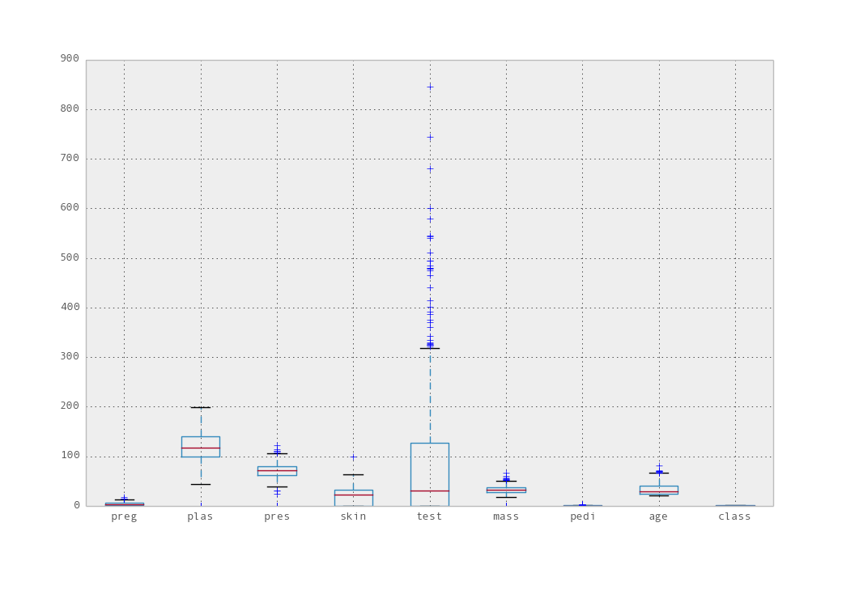
Ideal Use Case:
Multiple
Box-Plots Viewed Side By Side.

Slide 12
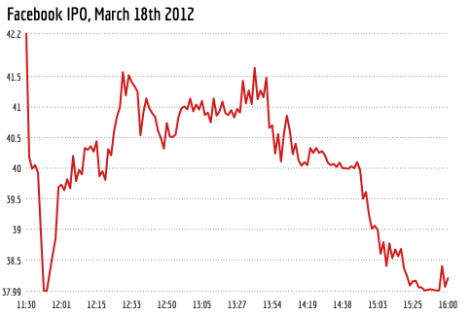
Line Plot
Generally used to describe the relationship between a SINGLE variable and time.
Great for finding trends in the data.
Example:
Facebook Stock Prices x Hour of Day

Slide 13
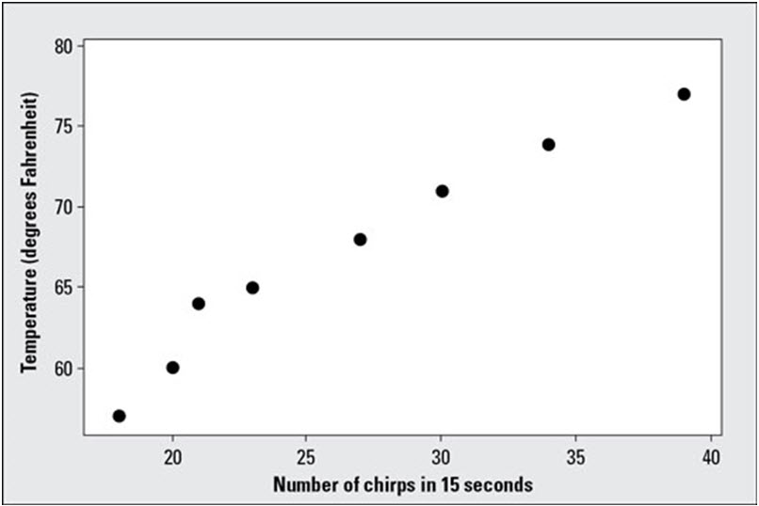
Scatter Plot
Shows relationship between TWO variables.
Generally used to discern a correlation between 2 variables.
Example:
Temp vs. cricket chirps in seconds.

Slide 14
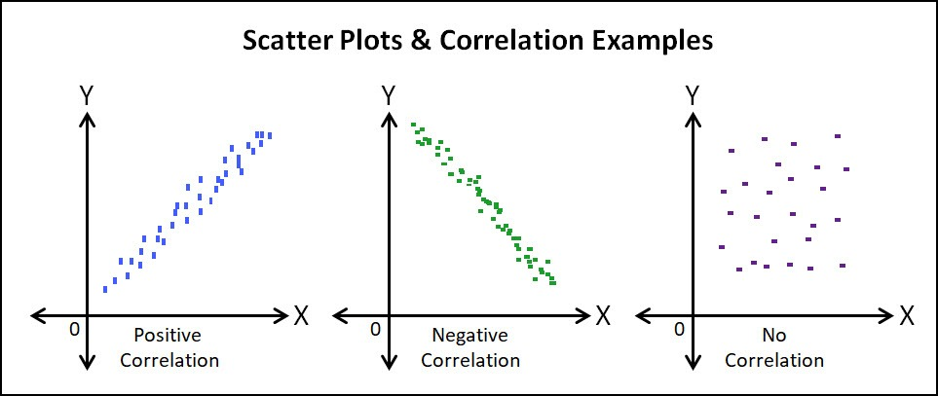
Scatter Plot Considerations
Linear: Can I draw a line through the data points?
Strength: How well does my line encompass points on graph?
Direction: Does the relationship have a positive or negative slope?
Outliers: Are there any outliers that may affect the relationship?

